Slide 1

Empowering India's EV Future: Time Series Analysis and PowerBI Visualization of Electric Vehicle Adoption.
MBS6099 – MASTER THESIS
FINAL REVIEW
Under the guidance of
Dr. Jitendra Kumar
(Associate Professor)
Dept. of Mathematics
School of Advanced Sciences
Project By
Vrinda S Nair (22MBS0024)
Msc Business Statistics
Dept. of Mathematics
School of Advanced Sciences

Slide 2
CONTENT
Problem Statement
Abstract
Literature Review
Methodology
Results
Conclusion
Future Work
Reference

Slide 3
PROBLEM STATEMENT
Transport is a basic need for modern living. Vehicles powered by petrol or diesel emit a
great deal of pollution, and fully electric vehicles are rapidly taking their place. Fully electric
vehicles (EVs) are significantly better for the environment and have zero exhaust emissions.
In comparison to an equivalent petrol or diesel vehicle, an electric vehicle has substantially lower operating costs. Since electric vehicles require less energy to charge than petrol or diesel to meet our travel needs, charging an electric vehicle is more cost-effective than filling it up.
In contrast to internal combustion vehicles, electric vehicles have significantly fewer moving parts, which results in extremely low maintenance costs. Electric vehicles require less maintenance than traditional petrol or diesel vehicles. As a result, maintaining an electric car has very little annual cost.
Because electric vehicles emit no tailpipe emissions, driving one can help one lower their carbon footprint. By selecting renewable energy options for your home's electricity, you can further lessen the environmental impact of charging your vehicle.
Compared to petrol or diesel vehicles, electric vehicle registration fees and road tax are lower. Depending on the state you live in, the government offers different policies and incentives.

Slide 4
LITERATURE REVIEW
In the transportation sector, electric vehicles (EVs) have become a viable way to lessen reliance on
fossil fuels and address environmental issues.
A “Global Comparison and Assessment of Incentive Policies for Electric Vehicle Promotion,” conducted by Ning Wang, Linhao Tang, and Huizhong Pan (2018). provides valuable insights for policymakers, industry stakeholders, and researchers seeking to accelerate the transition towards sustainable transportation systems. By understanding the strengths and limitations of existing incentive policies and learning from global best practices, countries can develop more effective strategies to promote EV adoption and achieve their environmental and energy objectives.
“Technology Development of Electric Vehicles: A Review” by Xiaoli Sun, Zhengguo Li, Xiaolin Wang and Chengjiang Li (2019) provides valuable insights into the current state of EV technology development and identifies opportunities for future innovation and research. By addressing challenges related to battery technology, electric drivetrains, and charging infrastructure, the EV industry can accelerate the transition towards sustainable transportation and contribute to global efforts to mitigate climate change and reduce air pollution.

Slide 5
“Electric Drive Technology: Trends, Challenges, and Opportunities for Future Electric Vehicles” by Iqbal Husain, MD Sariful Islam, Emre Gurpinar, Wensong Yu, Lincoln Xue, Dhrubo Rahman, and Raj Sahu (2020) provides a comprehensive overview of the current state and future prospects of electric drive technology in the context of EVs. By addressing technical challenges and embracing emerging opportunities, the electric drive technology sector can play a pivotal role in advancing the transition towards sustainable transportation and shaping the future of mobility.
“Adoption of Electric Vehicles: A Literature Review and Prospects for Sustainability” by Rajeev Ranjan Kumar, Kumar Alok (2019) provides valuable insights into the current state and future prospects of EV adoption in the context of sustainability. By addressing challenges and leveraging opportunities, policymakers, industry stakeholders, and researchers can work together to accelerate the transition towards a sustainable transportation system powered by electric vehicles.
“A Review on Electric Vehicles: Technologies and Challenges” by Julio A. Sanguesa 1, Vicente Torres-Sanz, Piedad Garrido, Francisco J. Martinez and Johann M. Marquez-Barja (2021) provides valuable insights into the current state and future prospects of EV technology. By addressing technical, economic, and policy challenges, stakeholders can work together to accelerate the transition towards a sustainable transportation system powered by electric vehicles.

Slide 6
METHODOLOGY
PowerBI Visualization
Microsoft Power BI is a data visualization and reporting platform that is used by businesses and professionals every day.
While the platform is commonly used by business analysts, it is also designed to be easily accessible for those without any specialized data knowledge.
It is a collection of software services, apps, and connectors that work together to turn various sources of data into static and interactive data visualizations.

Slide 7
ARIMA (Autoregressive Integrated Moving Average)
An autoregressive integrated moving average, or ARIMA, is a statistical analysis model that uses time series data to either better understand the data set or to predict future trends.
The model's goal is to predict future securities or financial market moves by examining the differences between values in the series instead of through actual values.
SARIMA (Seasonal Autoregressive Integrated Moving Average)
SARIMA is an excellent time series forecasting technique for estimating time series data with seasonal patterns.
It works by modeling the link between past and current values of a time series and recognizing patterns in the data.

Slide 8
XGBoost (eXtreme Gradient Boosting)
It is a machine learning algorithm that has become extremely popular and widely used due to its exceptional performance in a variety of machine learning tasks, such as regression and classification, as well as its ability to handle large datasets.
Because XGBoost can handle missing values effectively, it's a useful tool for handling missing values in real-world data. It combines the predictions of multiple weak models into a single, stronger prediction.
Random Forrest
It is the process of combining multiple classifiers to solve a difficult problem and improve the functionality of the model, forms the basis of it.
The random forest makes predictions by aggregating the majority vote of predictions from all decision trees, as opposed to relying solely on one.

Slide 9
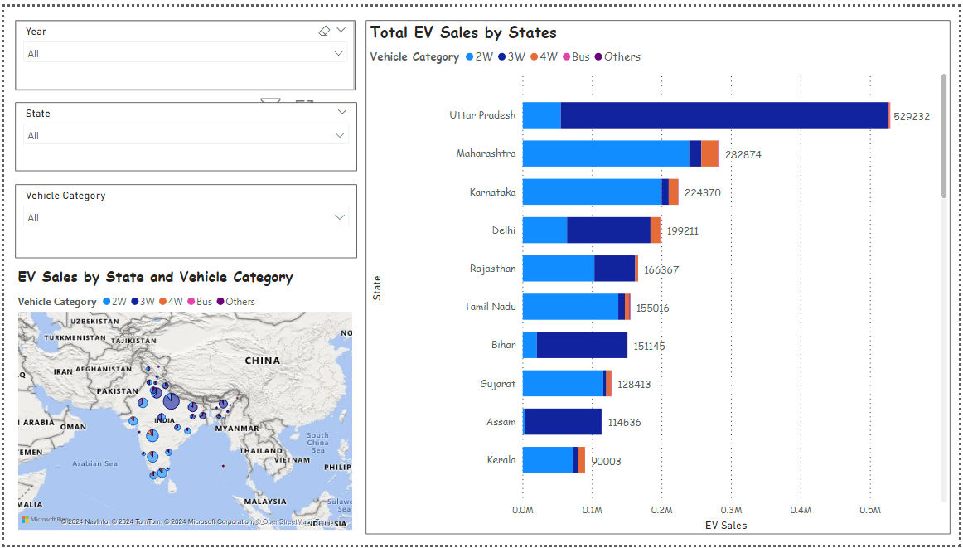
POWERBI VISUALIZATION

Slide 10
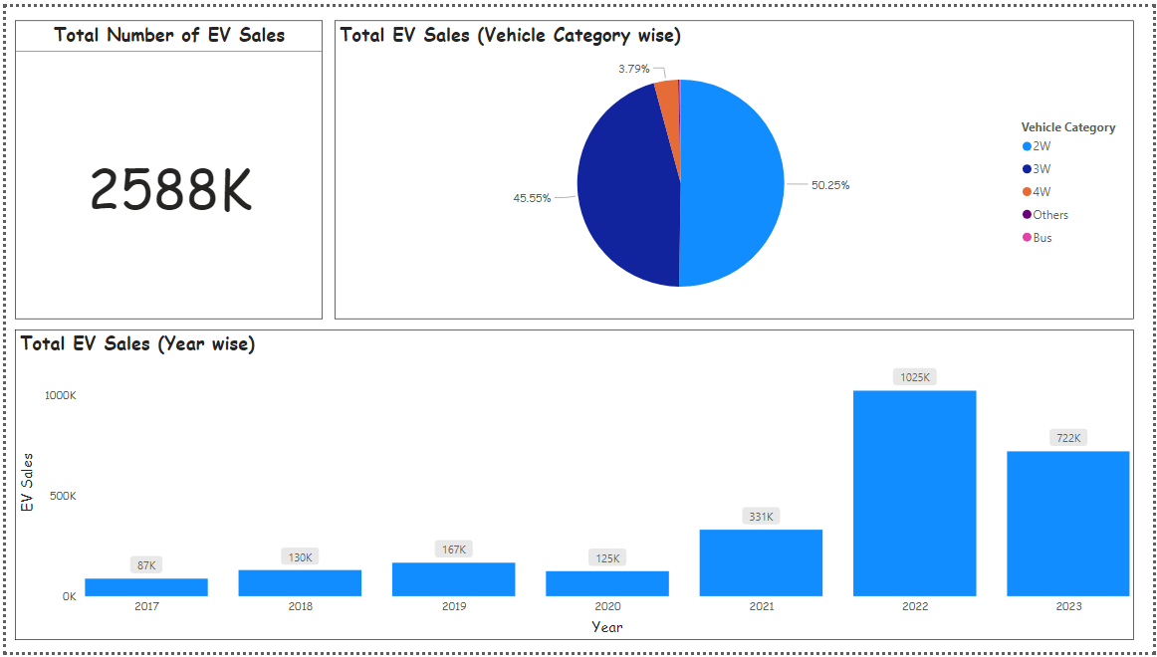

Slide 11
From the first visualization, we note that Uttar Pradesh is having the highest number of EV sales in India mostly in 3 Wheeler vehicles. Most number of sales for 2 Wheelers are in Maharashtra.
Further, we can analyse the sales of electric vehicles by using the filter (Year, state and vehicle category).
Also, the geographic map shows the sales of EVs. The place where it is having big bubble is having the highest number of sales (Uttar Pradesh) from 2017 to 2023.
From the second visualization, we note that EV sales was higher in the year 2022 followed by 2023.
Also, we can analyse the sales by vehicle category and we not that most of the sales have been done in 2 wheelers.

Slide 12
RESULTS
Time Series
We note from the below table that the best time series model is SARIMA as it is having more RMSE than ARIMA. Further, it shows that the data is following seasonality.
 | ARIMA | SARIMA
Mean Squared Error (MSE) | 19,69,339.84 | 49870.72
Root Mean Squared Error (RMSE) | 1403.33 | 223.32

Slide 13
Machine Learning
We note from the below table that XGBoost is providing better RMSE and R2 compared to Random Forest. Therefore, XGBoost is the best machine learning model.
 | XGBoost | Random Forest
Root Mean Squared Error (RMSE) | 144.65 | 151.43
R-Squared (R2) | 0.85 | 0.84

Slide 14
CONCLUSION
We can forecast the sales of electric vehicles using SARIMA in time series and XGBoost in machine learning.
This will lead to proper and low wastage of resources and lower the cost of production.
This forecast can help the government to analyse and provide more subsidies if any, to further increase the sales of EV.
Based on the sales we can analyse the most number of sales happened in which state and provide infrastructure based on the same.

Slide 15
FUTURE WORK
We can further continue this forecast by using more advanced machine learning and deep learning models such as LSTM models, neural networks, prophet etc.
Further, we can extend the study by considering all types of vehicles for forecasting such as 3 wheelers, 4 wheelers, Bus and Others.
This work can be then implemented by government authorities for future analysis of EV sales.

Slide 16
REFERENCE
A global comparison and assessment of incentive policy on electric vehicle promotion. Ning Wang, Linhao Tang, Huizhong Pan, 2018
Technology Development of Electric Vehicles: A Review. Xiaoli Sun 1, Zhengguo Li 1,*, Xiaolin Wang 2 and Chengjiang Li 2, 2019
Electric Drive Technology Trends, Challenges, and Opportunities for Future Electric Vehicles. Iqbal Hussain, Md Sariful Islam, Emre Gurpinar, Wensong Yu, Lincoln Xue, Raj Sahu, 2021
Adoption of electric vehicle: A literature review and prospects for Sustainability. Rajeev Ranjan Kumar*, 1, Kumar Alok, 2019
A Review on Electric Vehicles: Technologies and Challenges. Julio A. Sanguesa 1,* , Vicente Torres-Sanz 1, Piedad Garrido 1, Francisco J. Martinez 1 and Johann M. Marquez-Barja 2, 2021
Forecasting Charging Demand of Electric Vehicles Using Time-Series Models. Yunsun Kim and Sahm Kim, 2021.
Time Series Forecasting using LSTM and ARIMA. Khulood Albeladi, Bassam Zafar, Ahmed Mueen, 2023.
Forecasting the Demand for Electric Vehicles: Accounting for Attitudes and Perceptions. Aurélie Glerum, Lidija Stankovikj, Michaël Thémans, Michel Bierlaire, 2014.

Slide 17
THANK YOU

